Slide 1


Matrices and Linear Regression
How can we combine them?

Slide 2
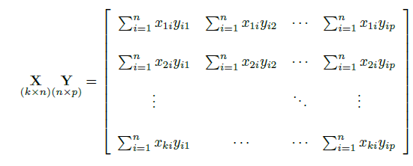
Recap of last time:

Slide 3
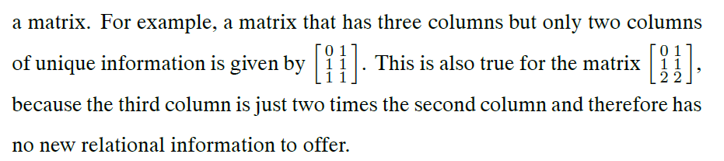
Disclaimer
The book is sometimes thoroughly confused.
You saw it with outer-product and cross-product.
Now with rows and columns.

Slide 4
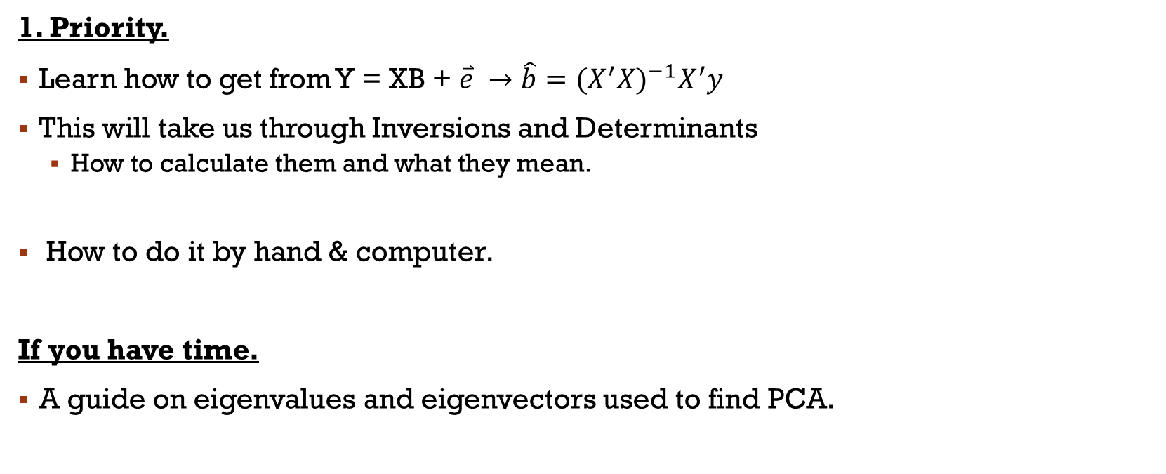
Goal for today
1. Priority.
Learn how to get from Y = XB + $\overset{⃑}{e}$ $→$ $\hat{b}={(X^{′}X)}^{−1}X^{′}y$
This will take us through Inversions and Determinants
How to calculate them and what they mean.
How to do it by hand & computer.
If you have time.
A guide on eigenvalues and eigenvectors used to find PCA.

Slide 5
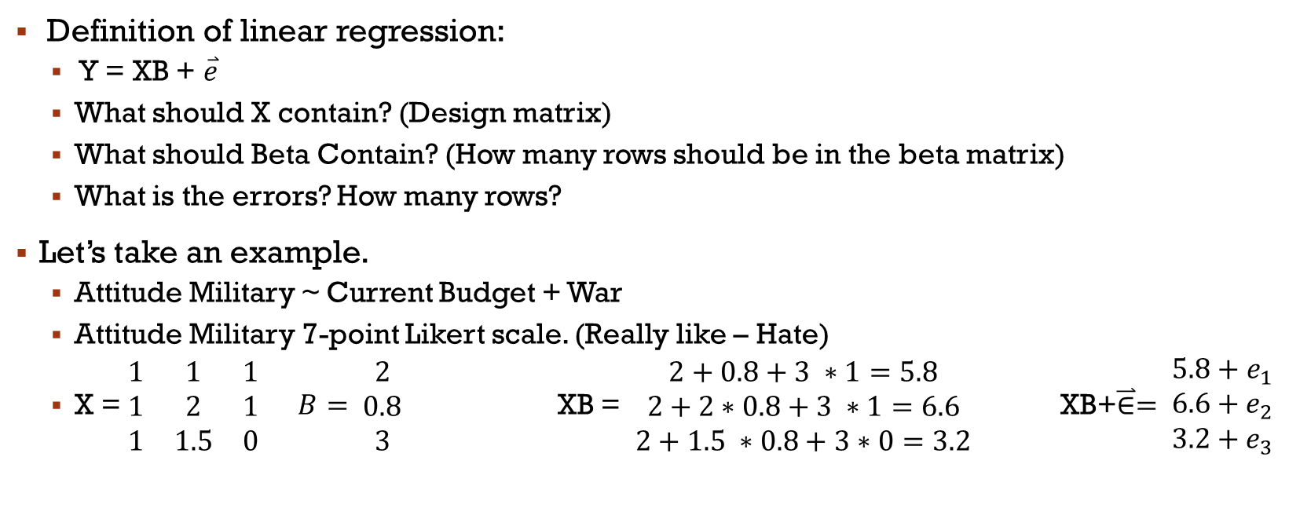
Linear model gone matrix.
Definition of linear regression:
Y = XB + $\overset{⃑}{e}$
What should X contain? (Design matrix)
What should Beta Contain? (How many rows should be in the beta matrix)
What is the errors? How many rows?
Let’s take an example.
Attitude Military ~ Current Budget + War
Attitude Military 7-point Likert scale. (Really like – Hate)
X = $\begin{matrix}1 & 1 & 1 \\ 1 & 2 & 1 \\ 1 & 1.5 & 0\end{matrix} B= \begin{matrix}2 \\ 0.8 \\ 3\end{matrix}$ XB = $\begin{matrix}2+0.8+3 ∗1=5.8 \\ 2+2∗0.8+3 ∗1=6.6 \\ 2+1.5 ∗0.8+3∗0=3.2\end{matrix}$ XB+$\overset{⃑}{∈}= \begin{matrix}5.8+e_{1} \\ 6.6+e_{2} \\ 3.2+e_{3}\end{matrix}$

Slide 6
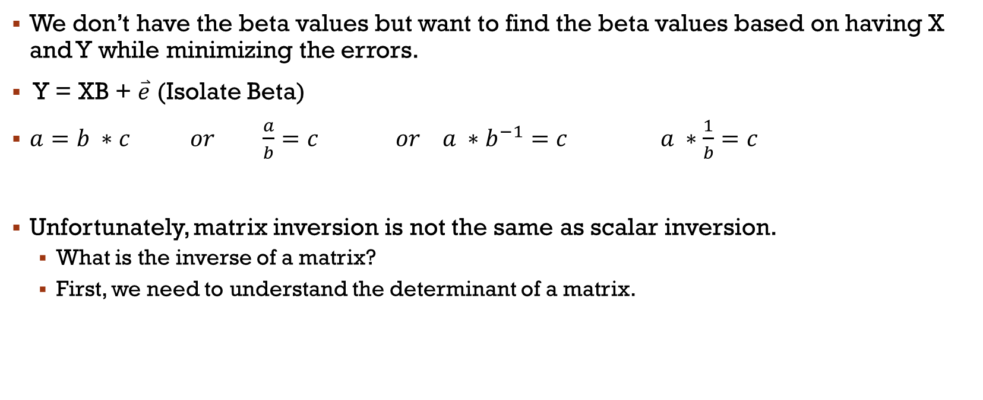
In real life!
We don’t have the beta values but want to find the beta values based on having X and Y while minimizing the errors.
Y = XB + $\overset{⃑}{e}$ (Isolate Beta)
$a=b ∗c or \frac{a}{b}=c or a ∗b^{−1}=c a ∗\frac{1}{b}=c$
Unfortunately, matrix inversion is not the same as scalar inversion.
What is the inverse of a matrix?
First, we need to understand the determinant of a matrix.

Slide 7
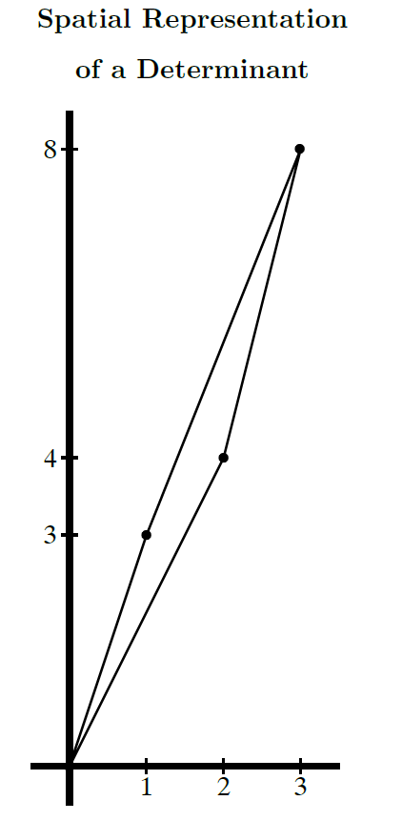
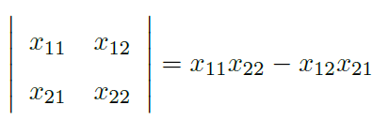
Determinant
We first need to understand determinants of a matrix.
Notation
det(X) = |X|
Interpretation:
Area of the parallelogram
More precisely manipulation of our space.
Calculation 2x2:

Slide 8
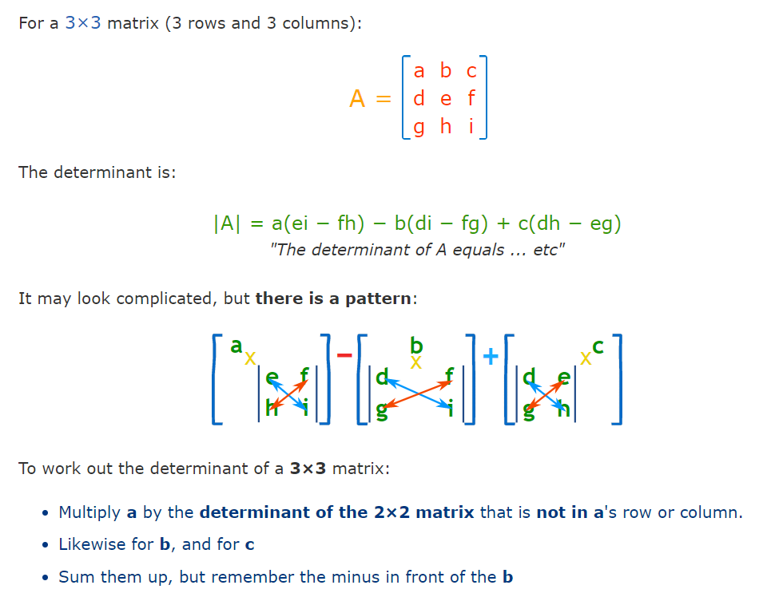
Determinant 3x3

Slide 9
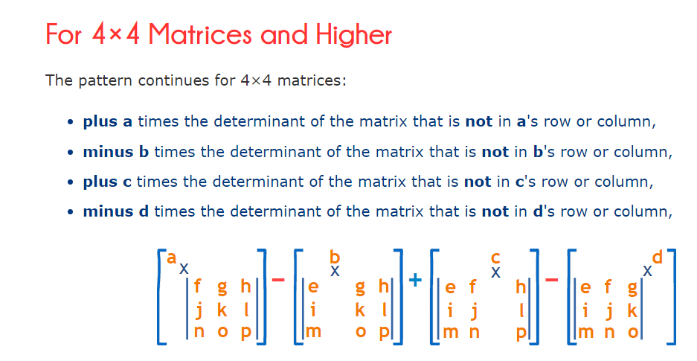
Determinant 4x4

Slide 10

Sign of operation.
Leave out row 1 and col 1.
Find determinant of the rest.
Use the correct sign depend on the location.
Uneven col/row (+)
Even col/row (-)
Onwards to inversion..

Slide 11
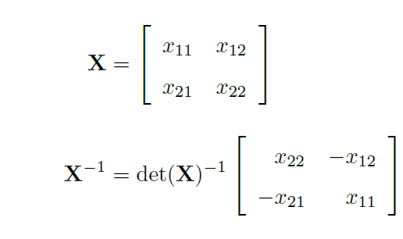
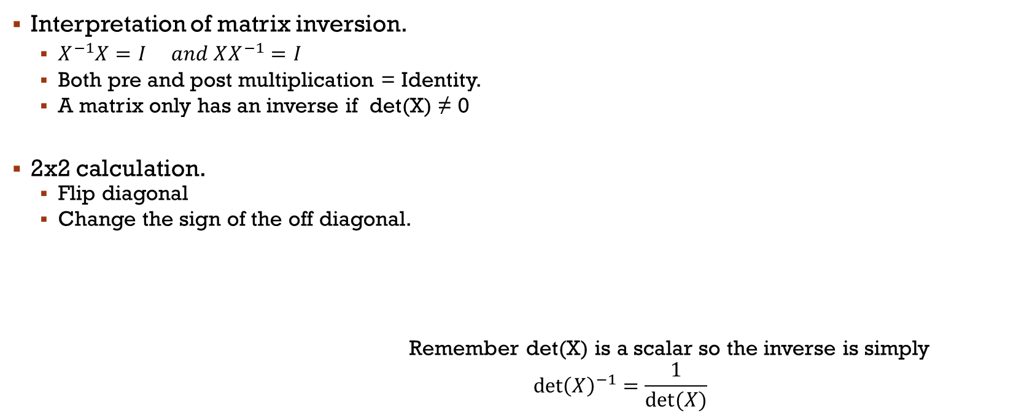
Inversion
See Chris’ video 4a for proof.
Interpretation of matrix inversion.
$X^{−1}X=I and XX^{−1}=I$
Both pre and post multiplication = Identity.
A matrix only has an inverse if det(X) ≠ 0
2x2 calculation.
Flip diagonal
Change the sign of the off diagonal.
Remember det(X) is a scalar so the inverse is simply
$$\det{{\left(X\right)}^{−1}}=\frac{1}{det⁡(X)}$$

Slide 12

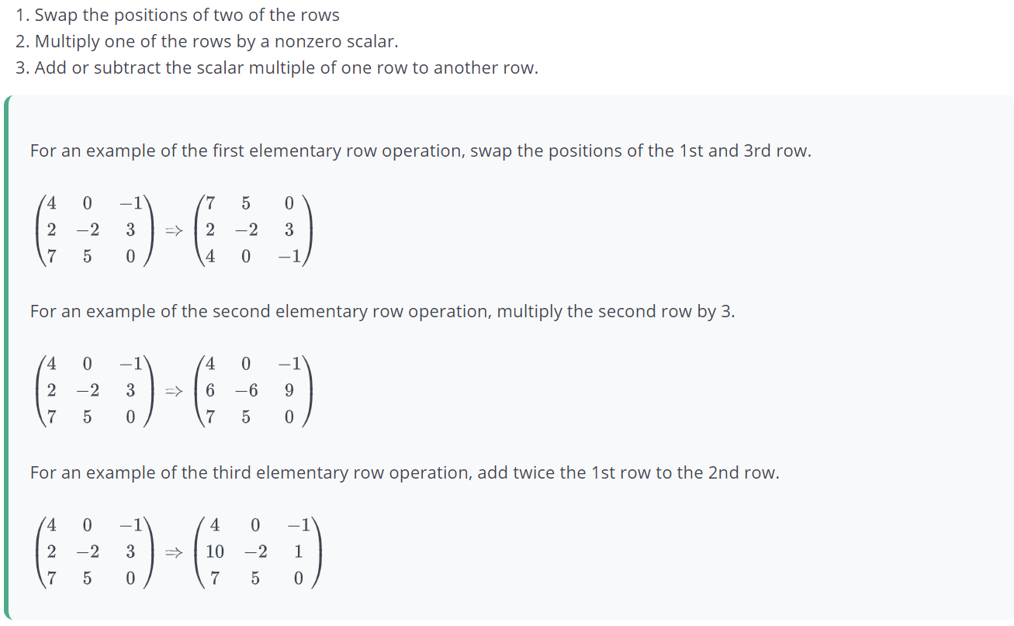

Inversion of larger matrices
Gauss-Jordan elimination.
An algorithm by which you can solve equations or find the inverse of matrices.
Rules to follow:
Swap rows
Multiply a row
Subtract or add the multiple of a row to another row.
Guide for Gauss-Jordan Elimination:
https://online.stat.psu.edu/statprogram/reviews/matrix-algebra/gauss-jordan-elimination

Slide 13
Good principles to follow.
Swap the rows so that all rows with all zero entries are on the bottom
Swap the rows so that the row with the largest, leftmost nonzero entry is on top.
Multiply the top row by a scalar so that top row's leading entry becomes 1.
Add/subtract multiples of the top row to the other rows so that all other entries in the column containing the top row's leading entry are all zero.
Repeat steps 2-4 for the next leftmost nonzero entry until all the leading entries are 1.
Swap the rows so that the leading entry of each nonzero row is to the right of the leading entry of the row above it.

Slide 14
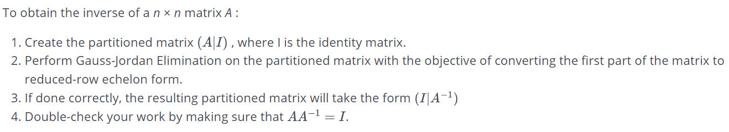
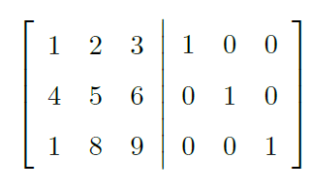
Inverse of matrices using gaus-Jordan Elimination.
The goal is to get the identity matrix on the left side by following the rules.
The matrix on the right will then be the inverse.

Slide 15
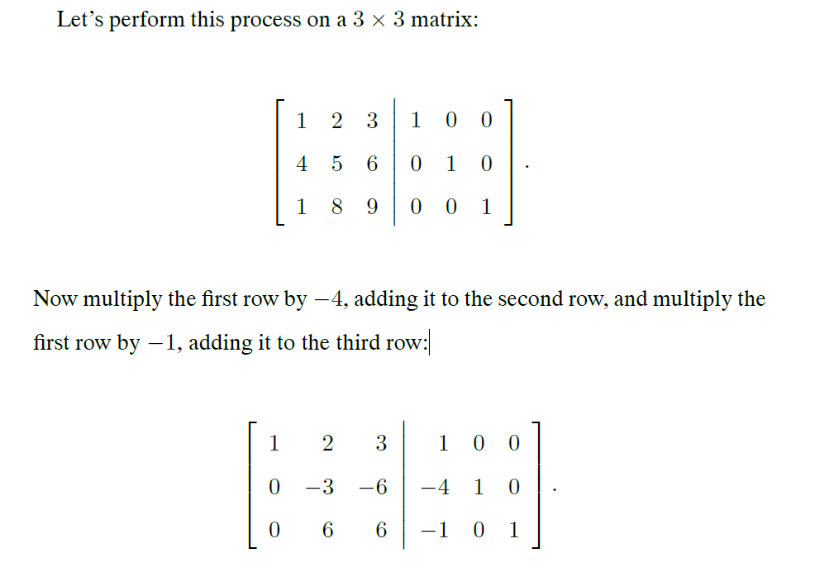
Example.

Slide 16
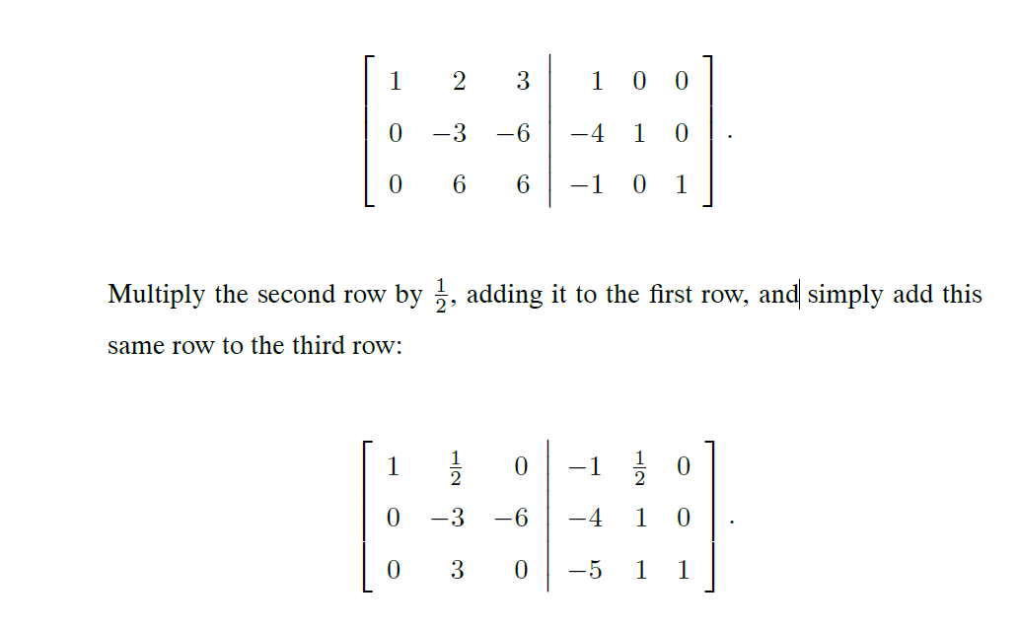
Example

Slide 17
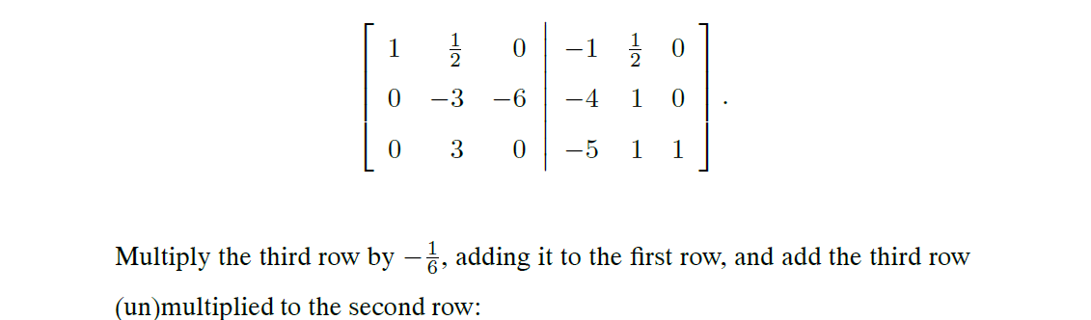
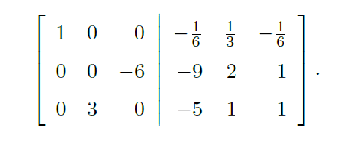
Example.

Slide 18
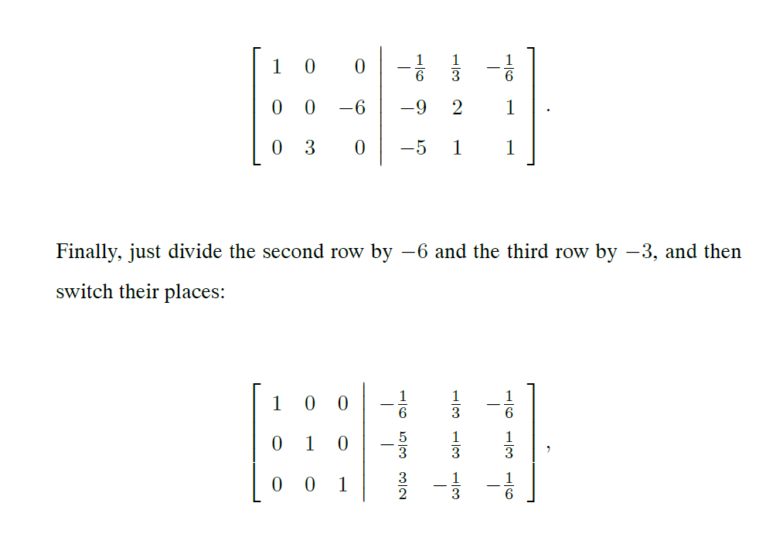
Example

Slide 19
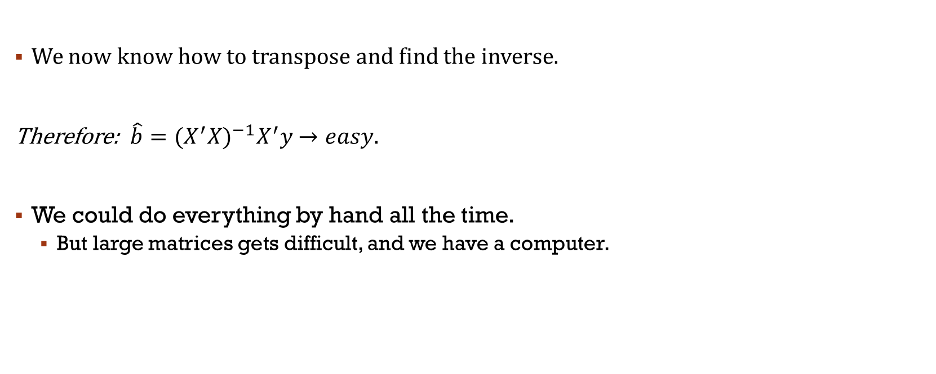
Now we can find beta.
We now know how to transpose and find the inverse.
Therefore: $\hat{b}={(X^{′}X)}^{−1}X^{′}y$ $→easy.$
We could do everything by hand all the time.
But large matrices gets difficult, and we have a computer.

Slide 20
Exercises
Check the Markdown file.
It contains:
Which exercises you should do by hand.
Introduction to matrix manipulation in R.
Exercises on using matrices in R to do OLS.

Slide 21
Eigenvalues, Eigenvectors & PCA
Guide on Eigenvectors and Values usage to remove collinearity (PCA) :
https://builtin.com/data-science/step-step-explanation-principal-component-analysis
Guide to PCA in R-studio:
https://www.datacamp.com/community/tutorials/pca-analysis-r

